Slide 1

Fractals: properties and applications
Math Co-op
VeronicA Ciocanel, brown university

Slide 2
Fractal ball experiment: DIY!

Slide 3
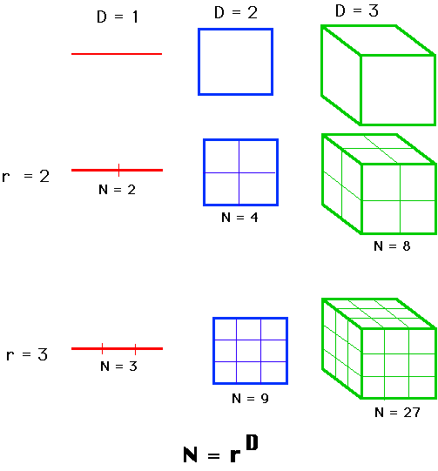
How do we think
of dimension?

Slide 4
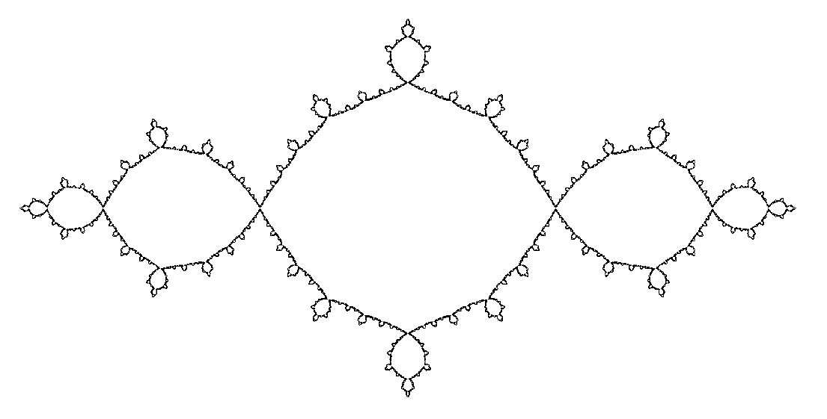
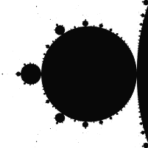
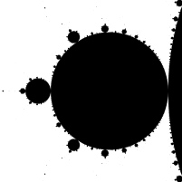
Conclusions: Fractal properties
Fractals exhibit fractal dimensions: all objects whose dimension is not an integer are fractals.
Fractals are self-similar.
d = 1.2683

Slide 5
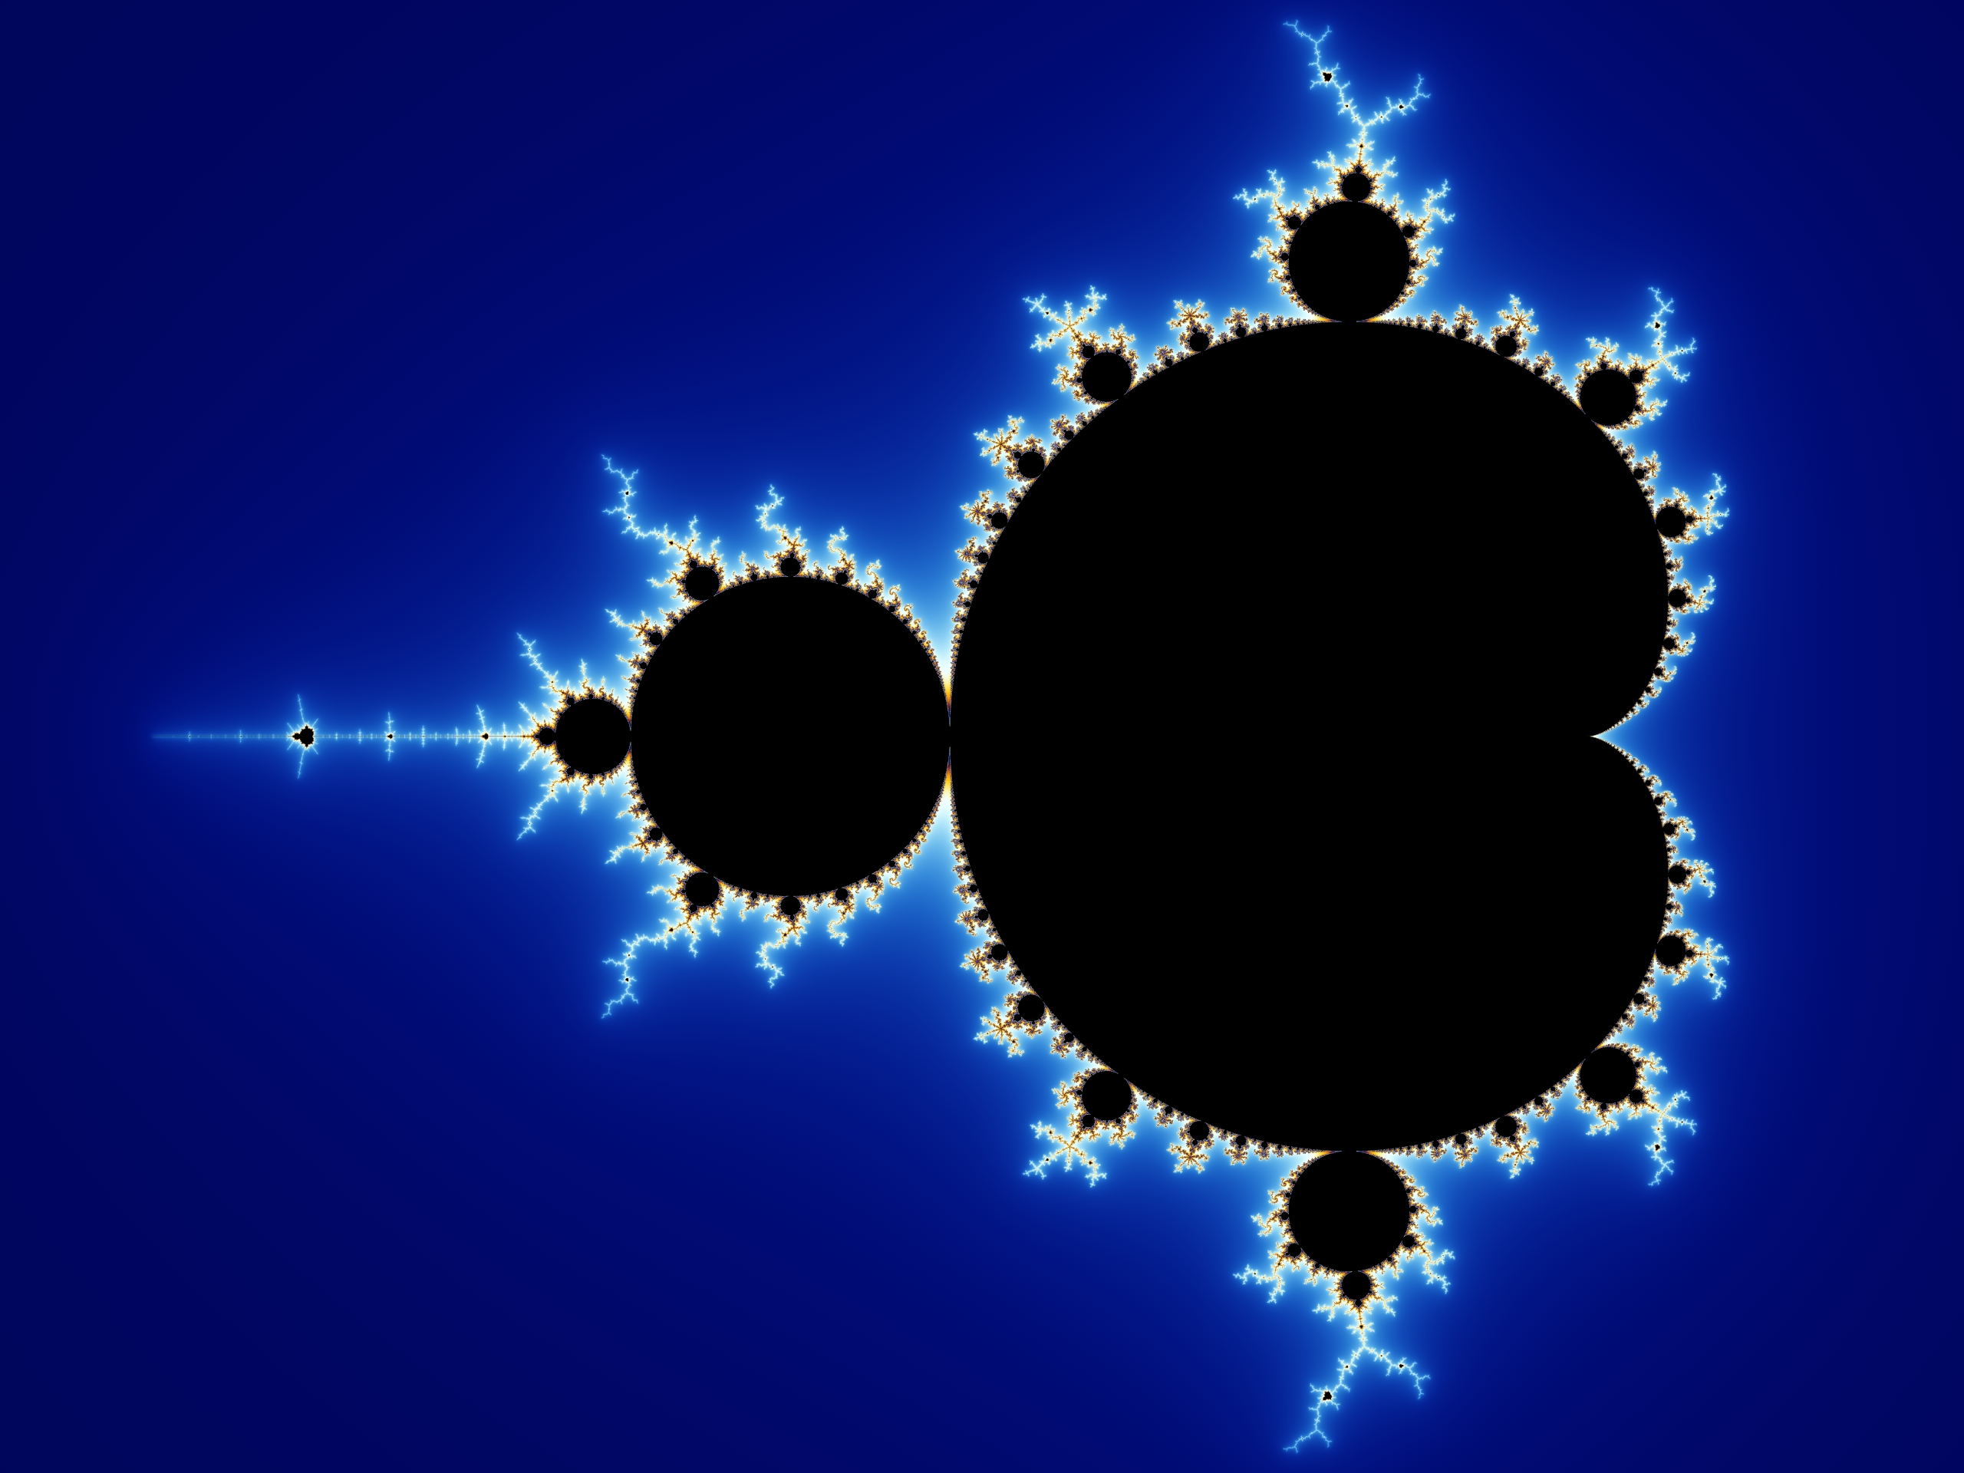
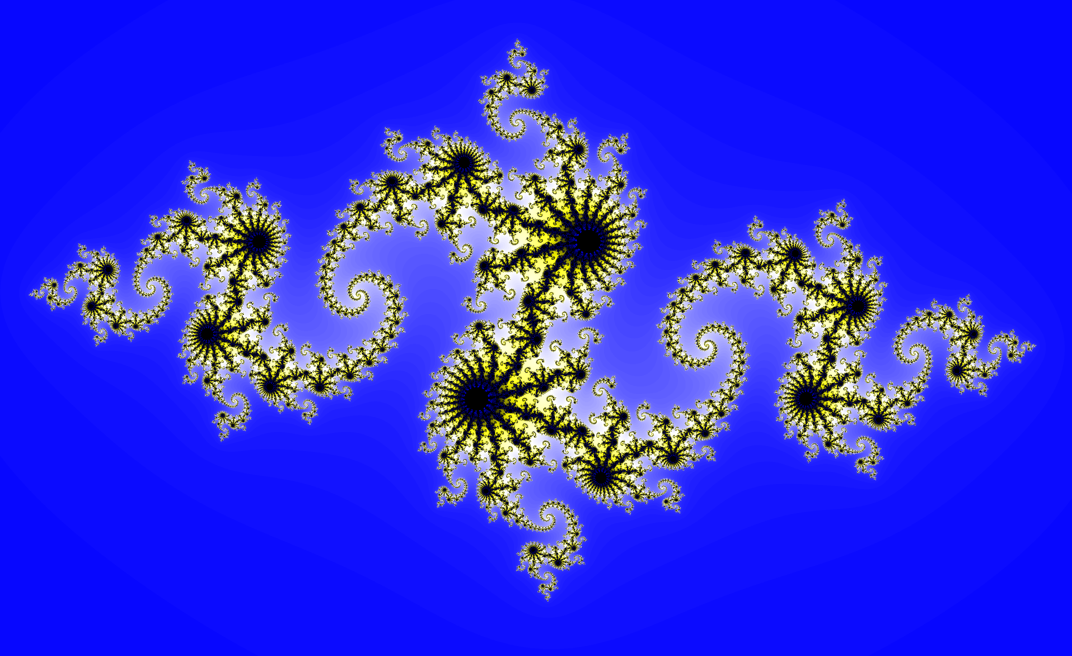
Fractals - mathematical objects
Mandelbrot set
Variation of a Mandelbrot set

Slide 6
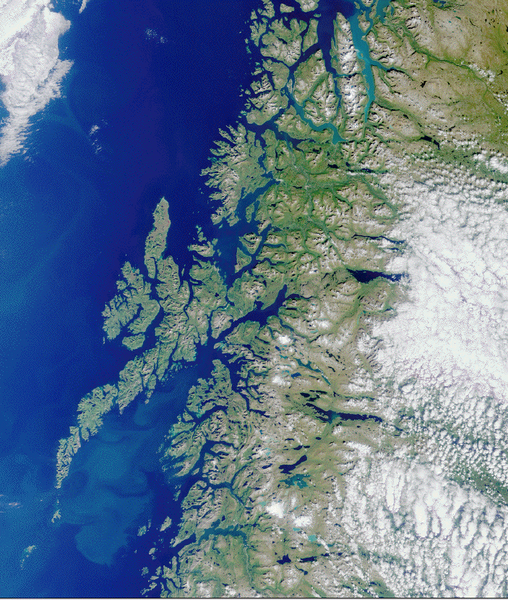
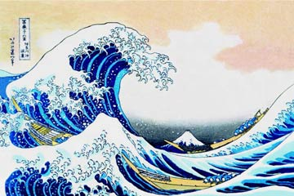
Fractals - around us
Lake Mead coastline
The Great Wave off Kanagawa - Hokusai

Slide 7
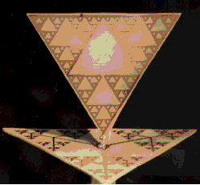
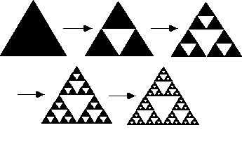
1. Fractal antennas
Sierpinski triangle
Example of fractal antenna

Slide 8
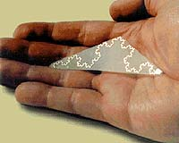
Fractal-shape antennas can respond to more frequencies than regular ones.
They can be ¼ the size of the regular ones: use in cellular phones and military communication hardware.
BUT: Not all fractal shapes are best suited for antennas.
Koch curve fractal antenna

Slide 9
2. Coastlines
Border length
987 km (reported by the Portuguese)
Portugal - Spain border
1214 km (reported by the Spanish)
Measurements were using different scales!

Slide 10
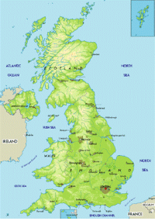
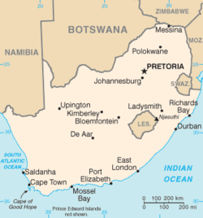
Returning to coastlines…
South Africa
Britain
Notes:
South Africa coastline: quite smooth; not the same can be said for Britain, as we can see in this map – turns out that this broken coastline makes measurements of the coastline length quite complicated, and a lot more scale-dependent.

Slide 11
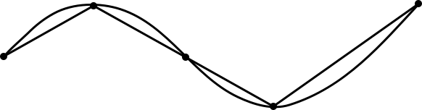
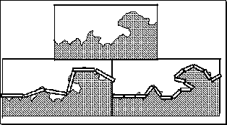
Approximating a smooth curve using straight lines – guaranteed to get closer to the true value of the curve length
Can we say the same for the UK coastline?

Slide 12
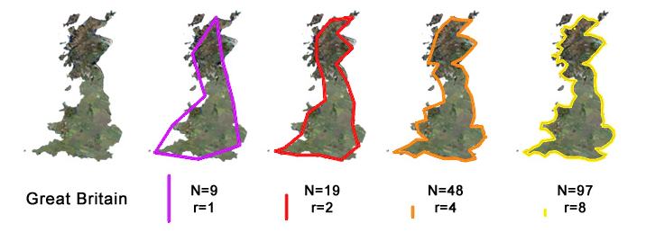
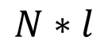

Scale/ruler length: $l=\frac{1}{r}$
Perimeter/length:
$$N∗l$$
$9∗\frac{1}{1}=9$ $19∗\frac{1}{2}=9.5$ 48$∗\frac{1}{4}=12 97∗\frac{1}{8}=12.125$

Slide 13
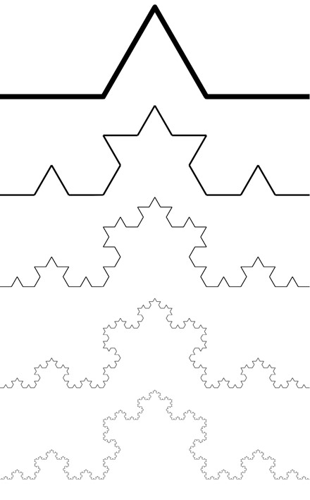
Coastlines have fractal-like properties: complexity changes with measurement scale
A lot like the Koch curve
This curve has infinite length!
Length: makes little sense
Notes:
Curves whose complexity changes with measurement scale
It can be proven the Koch curve has infinite length
This also shows that approximating the coastline by something akin to a Koch curve and using a ruler with a finer length leads to a larger and larger measured length

Slide 14
But, concept of fractal dimension makes sense!
South Africa: d = 1.02
Britain: d = 1.25
Notes:
As we may have predicted, the fractal dimension of the UK coast is higher! This makes its length more difficult to calculate, so that estimates of its perimeter vary wildly with the scale used.

Slide 15
This is called the “Coastline paradox”: measured length of a stretch of coastline depends on the measurement scale
But for practical use, the ruler scale is not that fine: km’s are enough!
Approximating the coastline with an infinite fractal is thus not so useful in this case.
Notes:
…the fine length of the ruler scale does not have to be on the order of cm’s, when looking at pebbles, etc. Rather, on the order of km’s

